Slide 1

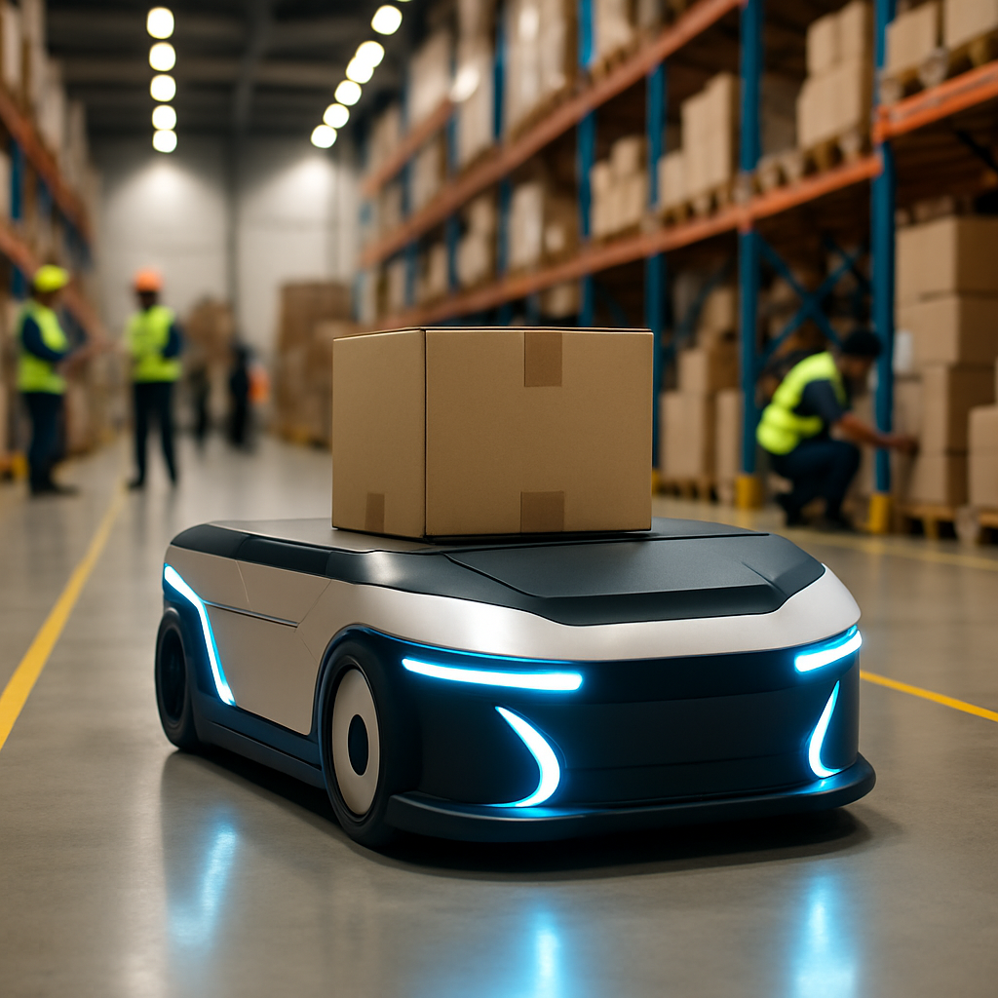


DHL WAREHOUSE AUTOMATION
SYSTEM
Notes:
warehouse automation system

Slide 2
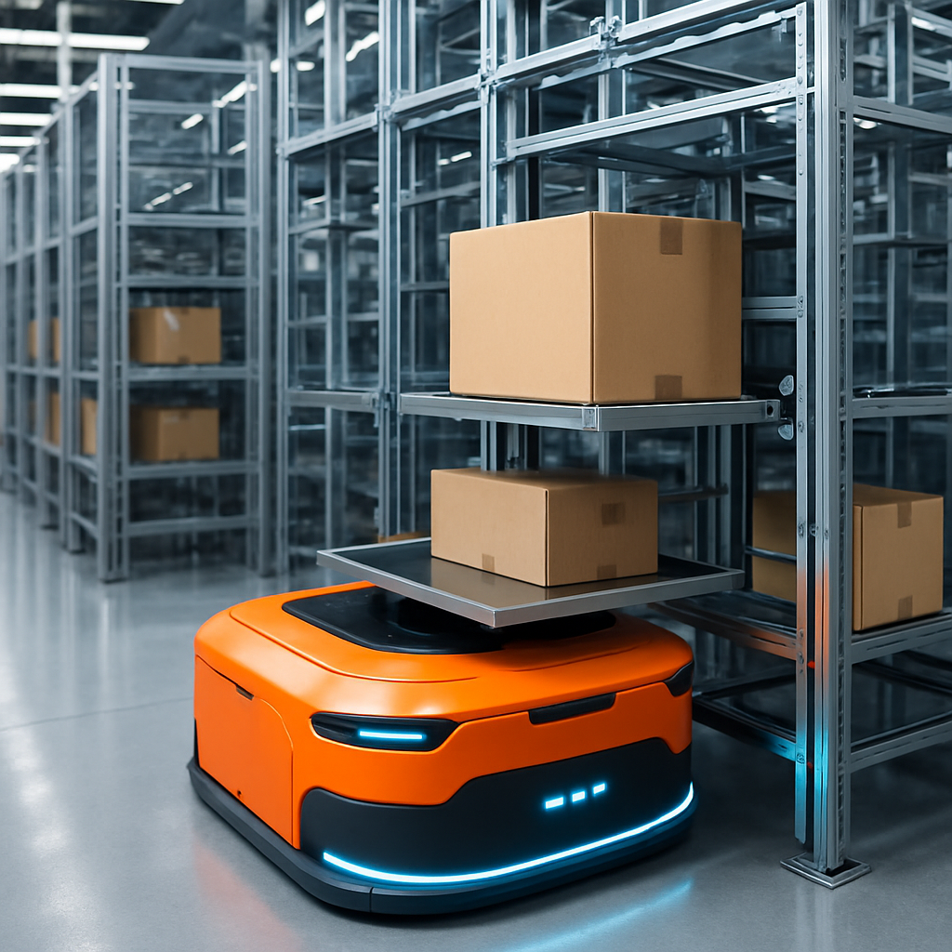

ROLES DISTRIBUTION
BERNARD WIDJAJA
RESOURCE (BOX,AGV)
STORAGEAREA
UI
MEGHANA HEMESH KUMAR
LOG MANAGER
PROCESS (STORING AND RETRIEVING)
RAJDEEP SHAW
CHARGING STATION
BATTERY
STORAGE SYSTEM
Notes:
This section outlines key roles in our warehouse automation system:
- Bernard Widjaja: Oversees resources such as boxes and AGVs, and ensures the user interface is intuitive.
- Meghana Hemesh Kumar: The Log Manager responsible for storing and retrieving items, crucial for operational efficiency and accuracy.
- Rajdeep Shaw: Manages charging stations and battery storage, ensuring AGVs are ready and energy flow is reliable.
Each role is essential to the system's success, leading to efficient warehouse management.

Slide 3
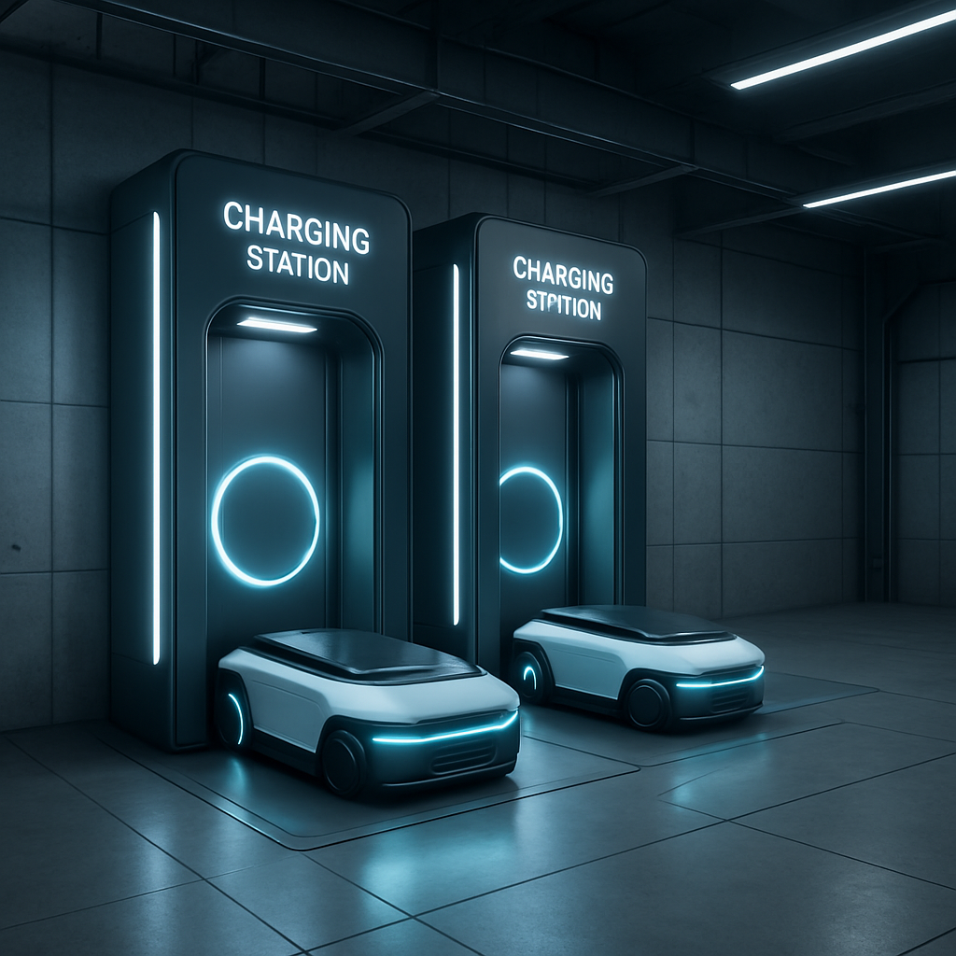
DESCRIPTION OF THE DOMAIN
DOMAIN:
AUTOMATED WAREHOUSE MANAGEMENT
DESCRIPTION:
HANDLING STORAGE AND RETRIEVAL OF BOXES EFFICIENTLY
MANAGING AUTONOMOUS GUIDED VEHICLES (AGVS)
MAINTAINING LOGS FOR AUDITING AND MONITORING
ENSURING SAFE AND CONCURRENT OPERATIONS
CHARGING THE AGVS WHEN THE BATTERY IS LOW
Notes:
Let's explore the domain of our Automated Warehouse Management System. Key aspects include:
- Efficient storage and retrieval of boxes to optimize space and time.
- Management of autonomous guided vehicles (AGVs) for smooth goods transportation.
- Maintaining logs for auditing and process monitoring.
- Prioritizing safety with protocols for smooth operations.
- Managing AGV charging without disrupting workflow.
These core functions enhance the efficiency and reliability of our automated warehouse system.

Slide 4
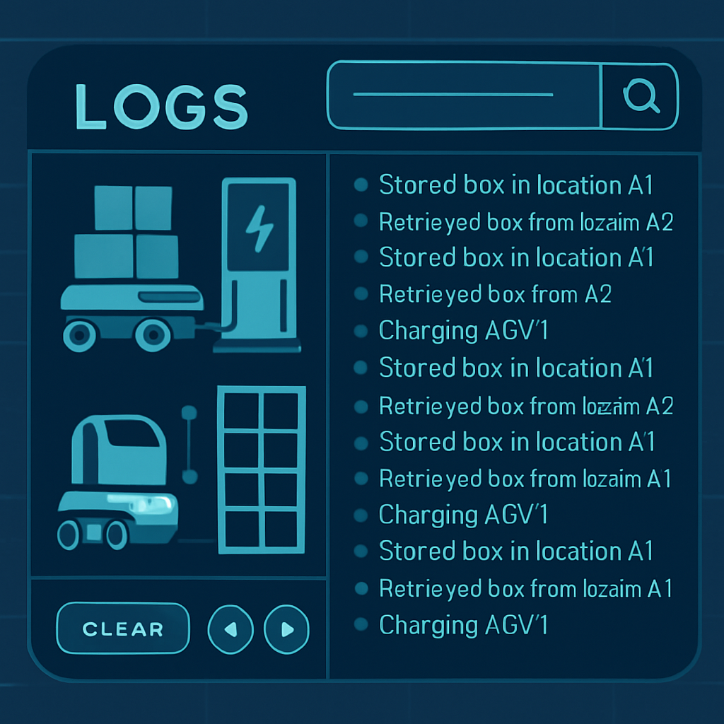
REQUIREMENTS TO THE SYSTEM
FUNCTIONAL REQUIREMENTS:
THE SYSTEM MUST ALLOW STORING AND RETRIEVING BOXES.
AGVS SHOULD MOVE TO PICKUP AND DROP POSITIONS.
EACH AGV MUST MONITOR ITS BATTERY LEVEL.
CHARGING STATIONS MUST HANDLE THE AGV CHARGING PROCESS.
IF A STATION IS UNAVAILABLE, THE AGV MUST EITHER WAIT OR THROW AN EXCEPTION AFTER TIMEOUT.
THE SYSTEM SHOULD LOG IMPORTANT EVENTS.
THE UI MUST ALLOW THE USER TO INTERACT WITH THE SYSTEM.
Notes:
The system should:
- Store and retrieve boxes.
- Enable AGVs to move to pickup and drop positions.
- Ensure each AGV monitors its battery level.
- Allow charging stations to manage AGV charging.
- Have AGVs wait or throw an exception if a station is unavailable after a timeout.
- Log important events.
- Provide a UI for user interaction.

Slide 5
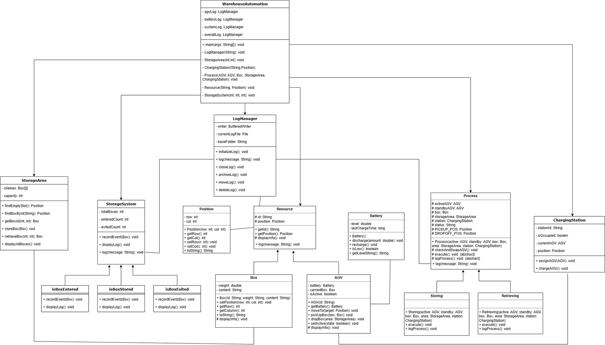
UML CLASS DIAGRAM

Slide 6
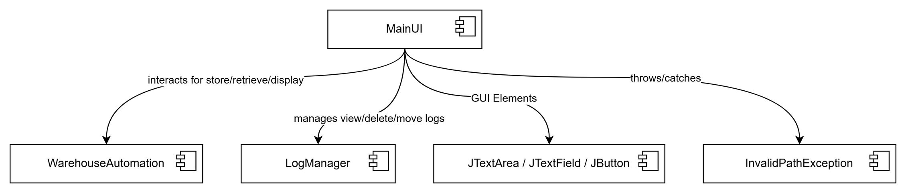
MAINUI
COMPONENT DIAGRAM

Slide 7
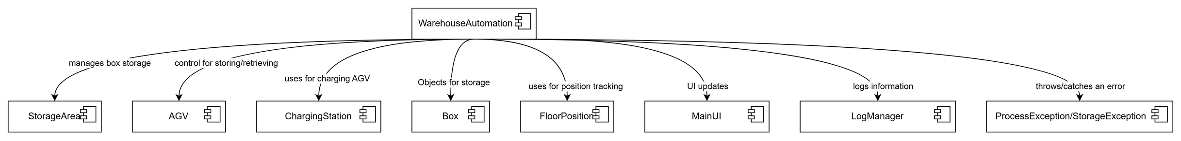
WAREHOUSEAUTOMATION
COMPONENT DIAGRAM

Slide 8
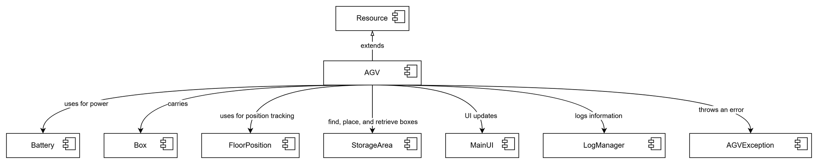
AGV
COMPONENT DIAGRAM

Slide 9
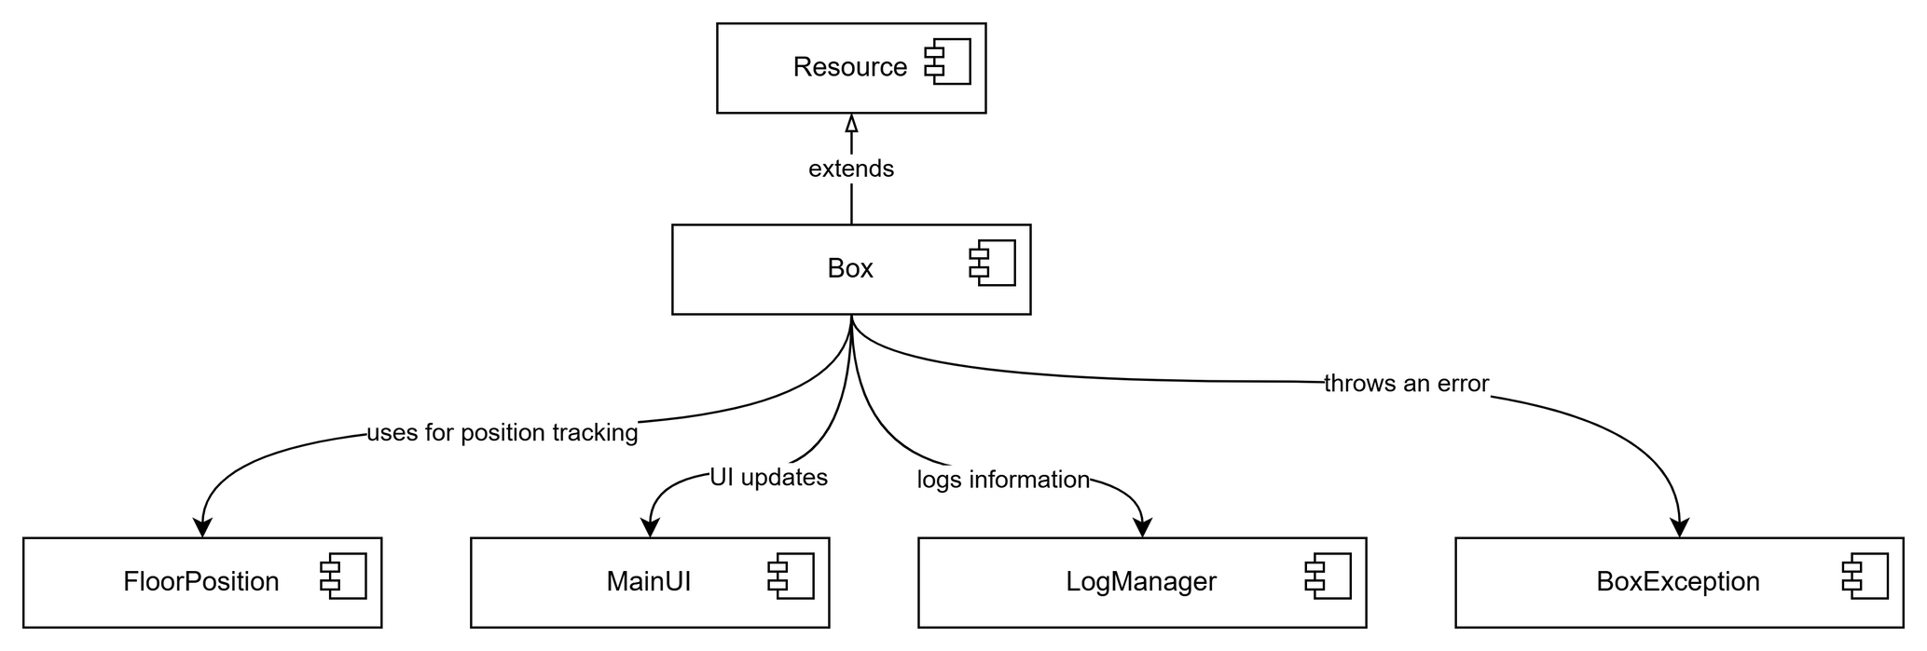
BOX
COMPONENT DIAGRAM

Slide 10
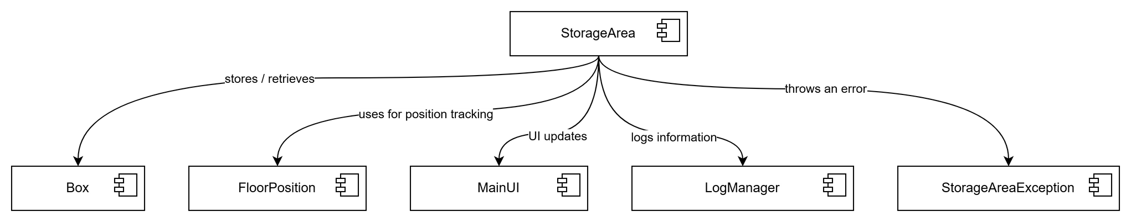
STORAGEAREA
COMPONENT DIAGRAM

Slide 11
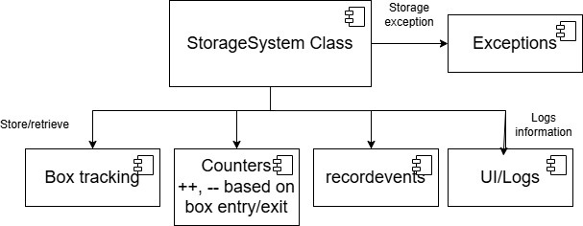
STORAGE SYSTEM
COMPONENT DIAGRAM

Slide 12
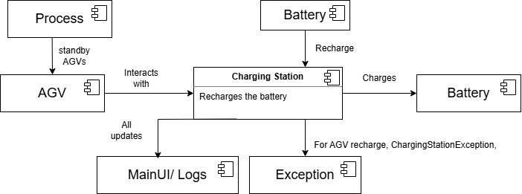
CHARGING STATION
COMPONENT DIAGRAM

Slide 13
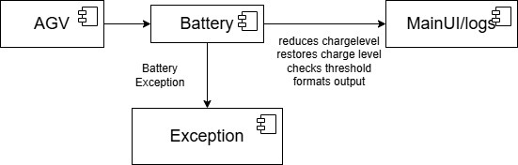
BATTERY
COMPONENT DIAGRAM

Slide 14
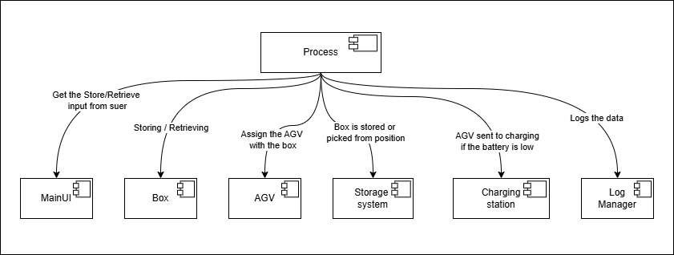
PROCESS
COMPONENT DIAGRAM

Slide 15
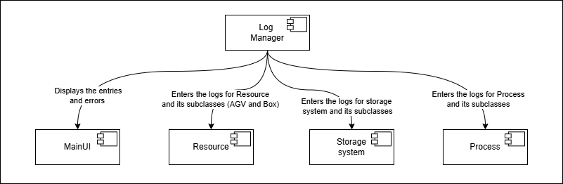
LOG MANAGER
COMPONENT DIAGRAM

Slide 16
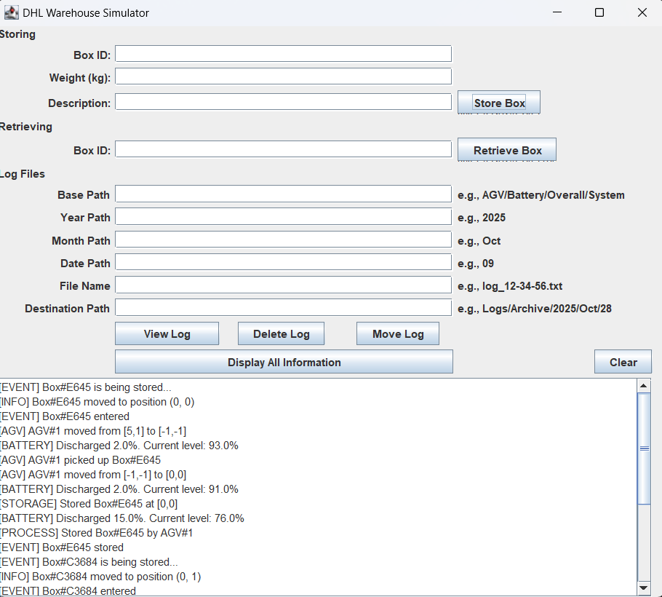
MANAGEMENT I/O IN THE SYSTEM
INPUTS:
STORING: BOX ID, WEIGHT, DESCRIPTION
RETRIEVING: BOX ID
LOG FILES: BASE PATH, YEAR, MONTH, DATE AND FILE NAME
VIEW LOG, DELETE LOG, MOVE LOG
DISPLAY ALL INFORMATION AND CLEAR
OUTPUTS:
MAINUI LOGS FOR USER
SYSTEM LOGS FOR AUDITING (AGV, BATTERY, OVERALL, SYSTEM)

Slide 17
USER INTERFACE
DEVELOPED USING JAVA SWING FOR USER-FRIENDLY INTERACTION.
Allows the user to store and retrieve boxes with unique IDs.
Provides fields for Box ID, Weight, Description, and Log Management
INCLUDES FEATURES TO:
Store / Retrieve boxes
View, Delete, Move logs
Display all information
Clear Text area
Displays real-time system events in the output area — including AGV movement, storage process, and battery UPDATES.

Slide 18

THREADS IMPLEMENTATION
SWAP LOGIC WHEN BATTERY IS LOW
STORING AND RETRIEVING SYNCHRONIZED
AGV ASSIGNMENT TO CHARGING STATION
→ If AGV1 is charging and AGV2’s battery becomes low, AGV2 waits for 15 mins.
→ This is controlled by threads and timers — a good example of concurrent behavior.
→ The storeBox() and retrieveBox() methods are synchronized to perform at the same time.
→ When multiple AGVs want to charge, only one should get the station at a time.
→ Code uses synchronization to ensure fair access.

Slide 19
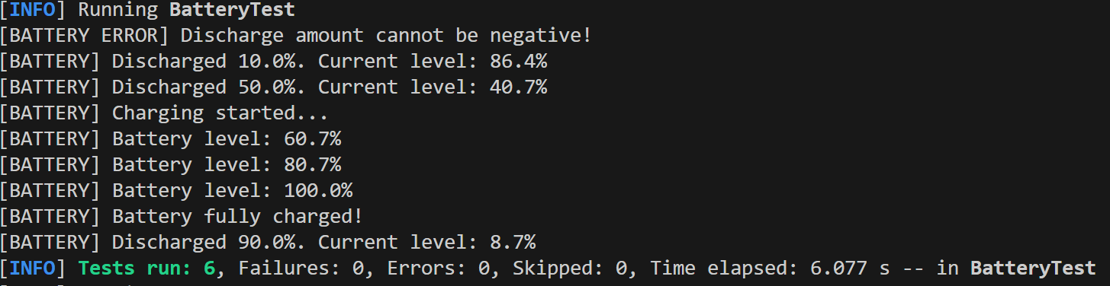
RESULTS OF THE UNIT TEST CASES
TESTCASES FOR BATTERY:
NEW BATTERY INITIALISATION
DISCHARGING BATTERY WHEN AGV IS PERFORMING TASK
INDICATE LOW BATTERY (WHEN HEAVILY DISCHARGED)
CHARGE VALUE SHOULD NOT BE NEGATIVE
PROPER FORMATTING FOR BATTERY UPDATES
RECHARGING AFTER DRAINING BATTERY SHOULD NOT CAUSE ERROR.

Slide 20
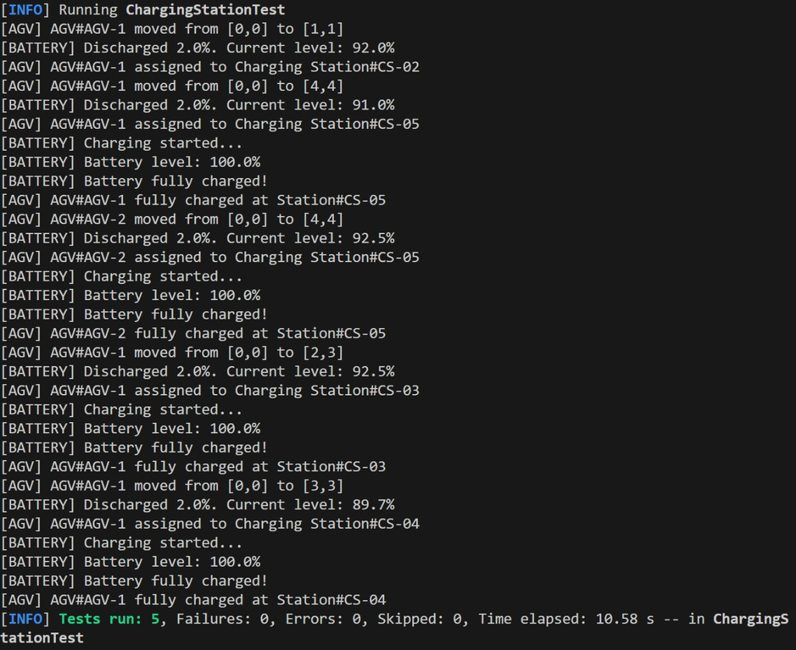
RESULTS OF THE UNIT TEST CASES
TESTCASES FOR CHARGING STATION:
TEST THAT A CHARGINGSTATION OBJECT CAN BE CREATED WITHOUT ERRORS
MAKING SURE ASSIGNING AGV MOVES IT TO THE STATION'S COORDINATES
THE STATION ONLY ACCEPTS ONE AGV AT A TIME; OTHER AGV STAYS PUT
CHARGING AN AGV AT THE STATION SHOULD NEARLY FIL THE BATTERY
BOTH AGVS SHOULD GET FULLY CHARGED WHEN ASSIGNED AND CHARGED OEN AFTER ANOTHER

Slide 21
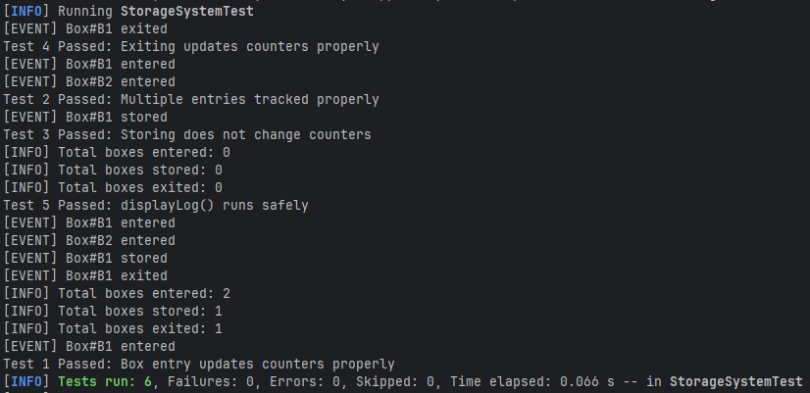
RESULTS OF THE UNIT TEST CASES
TESTCASES FOR STORAGESYSTEM:
EVERY BOX ENTRY SHOULD INCREASE BOTH COUNTERS BY 1
Two box entries should produce counts of 2
Recording a 'stored' event should not change box counts
Box exit should decrease total boxes and increase exited count
Displaying logs should not throw any erros

Slide 22
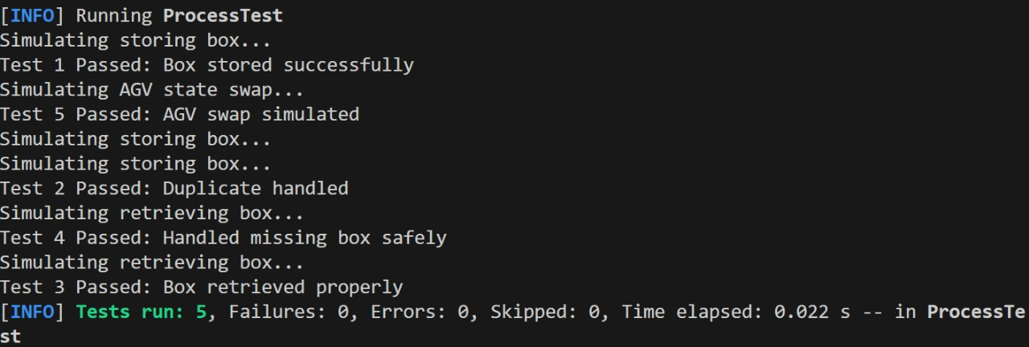
RESULTS OF THE UNIT TEST CASES
TESTCASES FOR PROCESS:
CHECK IF STORING BOX WORKS
Check if storing same box twice does not crash
Check retrieve function
Try to retrieve wrong box id
Swapping AGV's

Slide 23
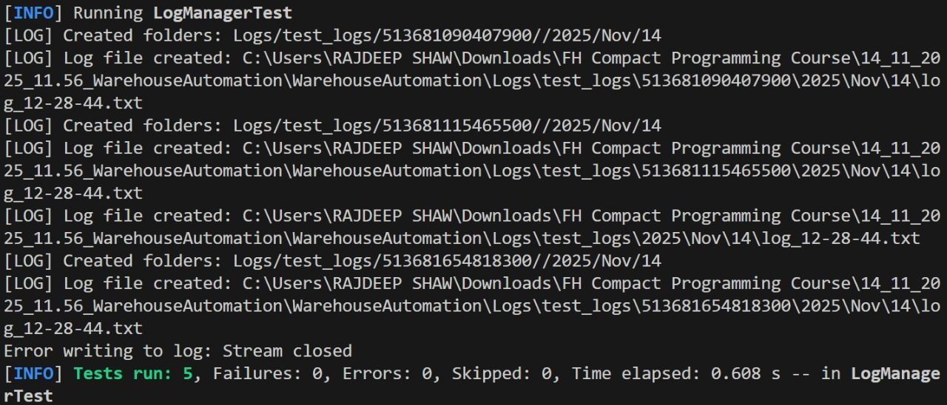
RESULTS OF THE UNIT TEST CASES
TESTCASES FOR LOG MANAGER:
CREATING A LOG IN VALID FOLDER SHOULD ACTUALLY CREATE A FILE
Trying to log to an invalid path should not crash the system
Logging file can be closed safely, even if already closed
After closing a log, its file can be moved to another location
Logging before calling init should not crash anything

Slide 24
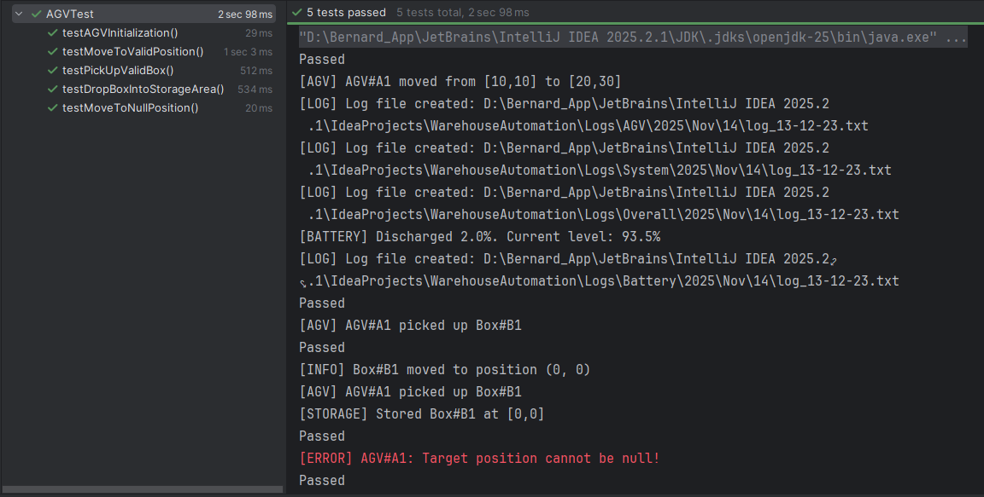
RESULTS OF THE UNIT TEST CASES
TESTCASES FOR AGV:
TEST AGV Initialization
Test Move to Valid Position
Test Move to Null Position
Test PickUp Valid Box
Test DropBox Into StorageArea

Slide 25
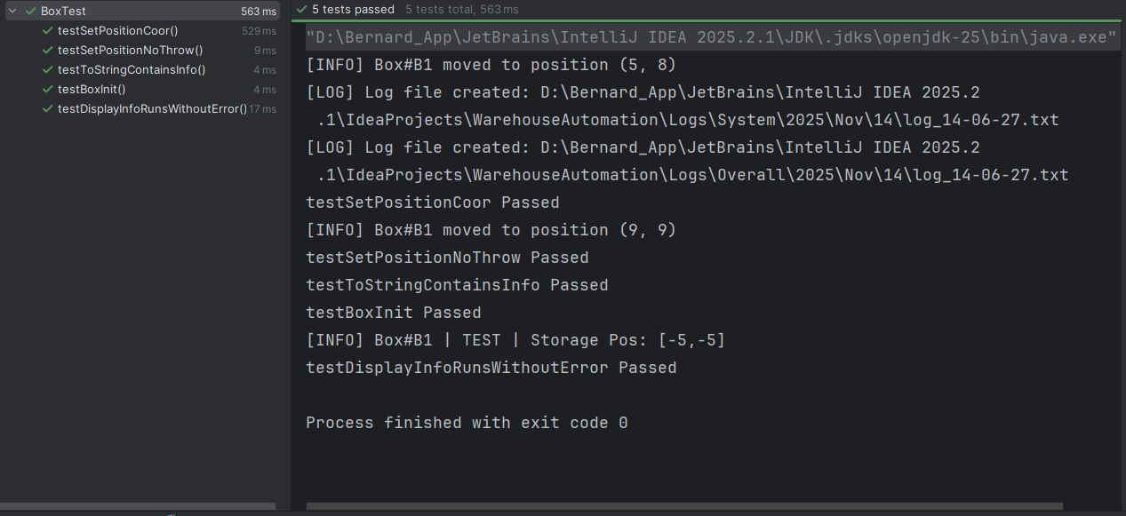
RESULTS OF THE UNIT TEST CASES
TESTCASES FOR BOX:
TEST BOX Initialization
Test SetPosition Coordinates
Test SetPosition No Throw
Test ToString Contains Information
Test DisplayInfo Runs WithoutError

Slide 26
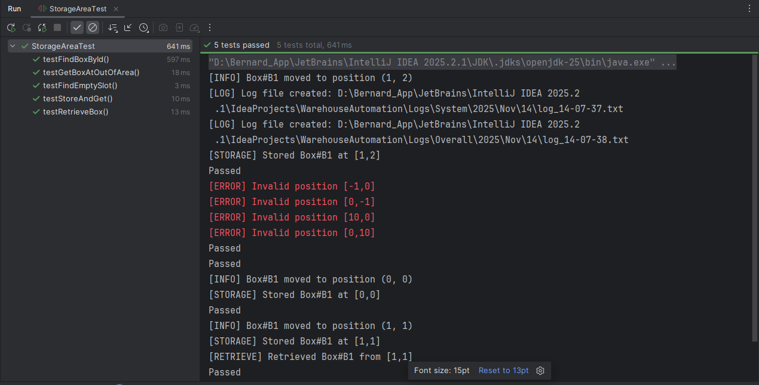
RESULTS OF THE UNIT TEST CASES
TESTCASES FOR STORAGE AREA:
TEST FindEmptySlot
Test Store and Get Box
Test FindBoxById
Test RetrieveBox
Test GetBox at Out of Area

Slide 27


